Slide 1
New Project
50%
50%
WeFund Community
WeFund Holder

Slide 2
Community Allocation
Round 1
100 hours for Bet
Count Nr of Bet
Round 1 = 50k
Nr of Bet = 50
Bet max Round 1 = 1k
If all the bet >= 1k => Done
If bet < 1k => we take and we go to Round 2

Slide 3
Community Allocation
Round 2
Count Nr of Bet Remaining
Round 2 = 10k
Nr of Bet >1k = 20
Bet max Round 2 = 500
If all the bet >= 500 => Done
If bet < 500 => we take and we go to Round 3
Round 3 same loop

Slide 4
WeFund holders
Min Holding 10 000 wfd
Allocation 1 Slot
1000 WeFans
Allocation 1 Slot
2000 WeFans
Allocation 2 Slot
WeFund Holder using 1000 WeFans Token for each extra slot, max 4000 WeFans Token
WeFund Staker generate WeFans
3000 WeFans
Allocation 3 Slot
4000 WeFans
Allocation 4 Slot

Slide 5
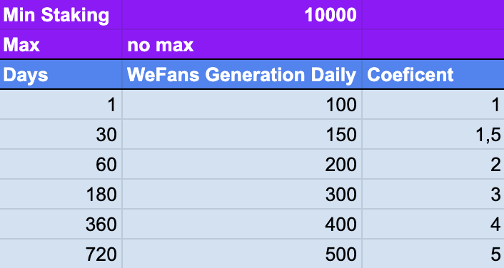
WeFund Staking

Slide 6
WeFund Holder Betting System
Round 1
100 hours for Bet
Count Nr of Bet with Slot allocation calculation, example 10 WeFund Holder 10 WeFund Holder + 1 extra Slot 10 WeFund Holder + 2 extra Slot 10 WeFund Holder + 4 extra Slot
Round 1 = 50k
Nr of Bet = 35, Total of Slot = 10+ 20 + 30 + 40 = 100 Slot
Bet max per Slot on Round 1 = 500
If all the bet >= 500 => Done
If bet < 500 => we take and we go to Round 2

